Slide 1

EZ-Drive
Members: Grant Galinger, Josh Phillips, Kyle Spraggins
Advisor: Professor Annexstein
Notes:
Hello, and welcome to our final presentation for our senior design project, Ez-Drive.
The members of our group include Josh Phillips, Kyle Spraggins, and myself, Grant Galinger. Our advisor for this project is Professor Annexstein.

Slide 2
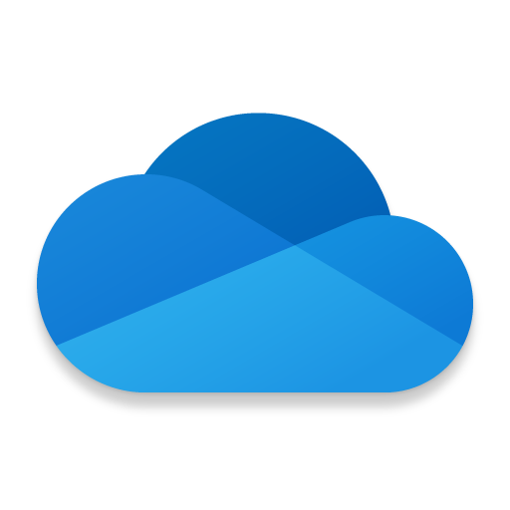
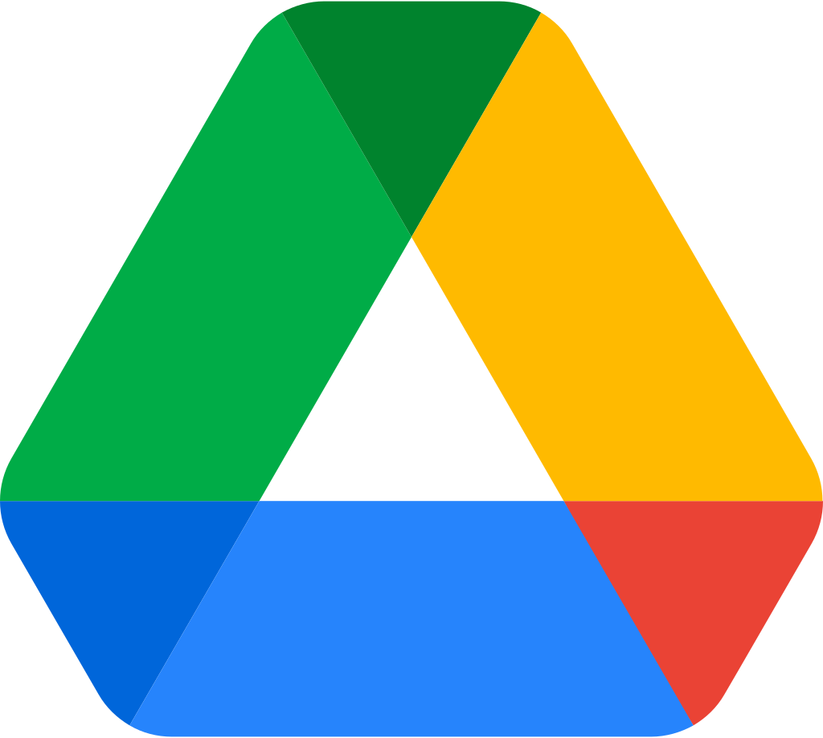
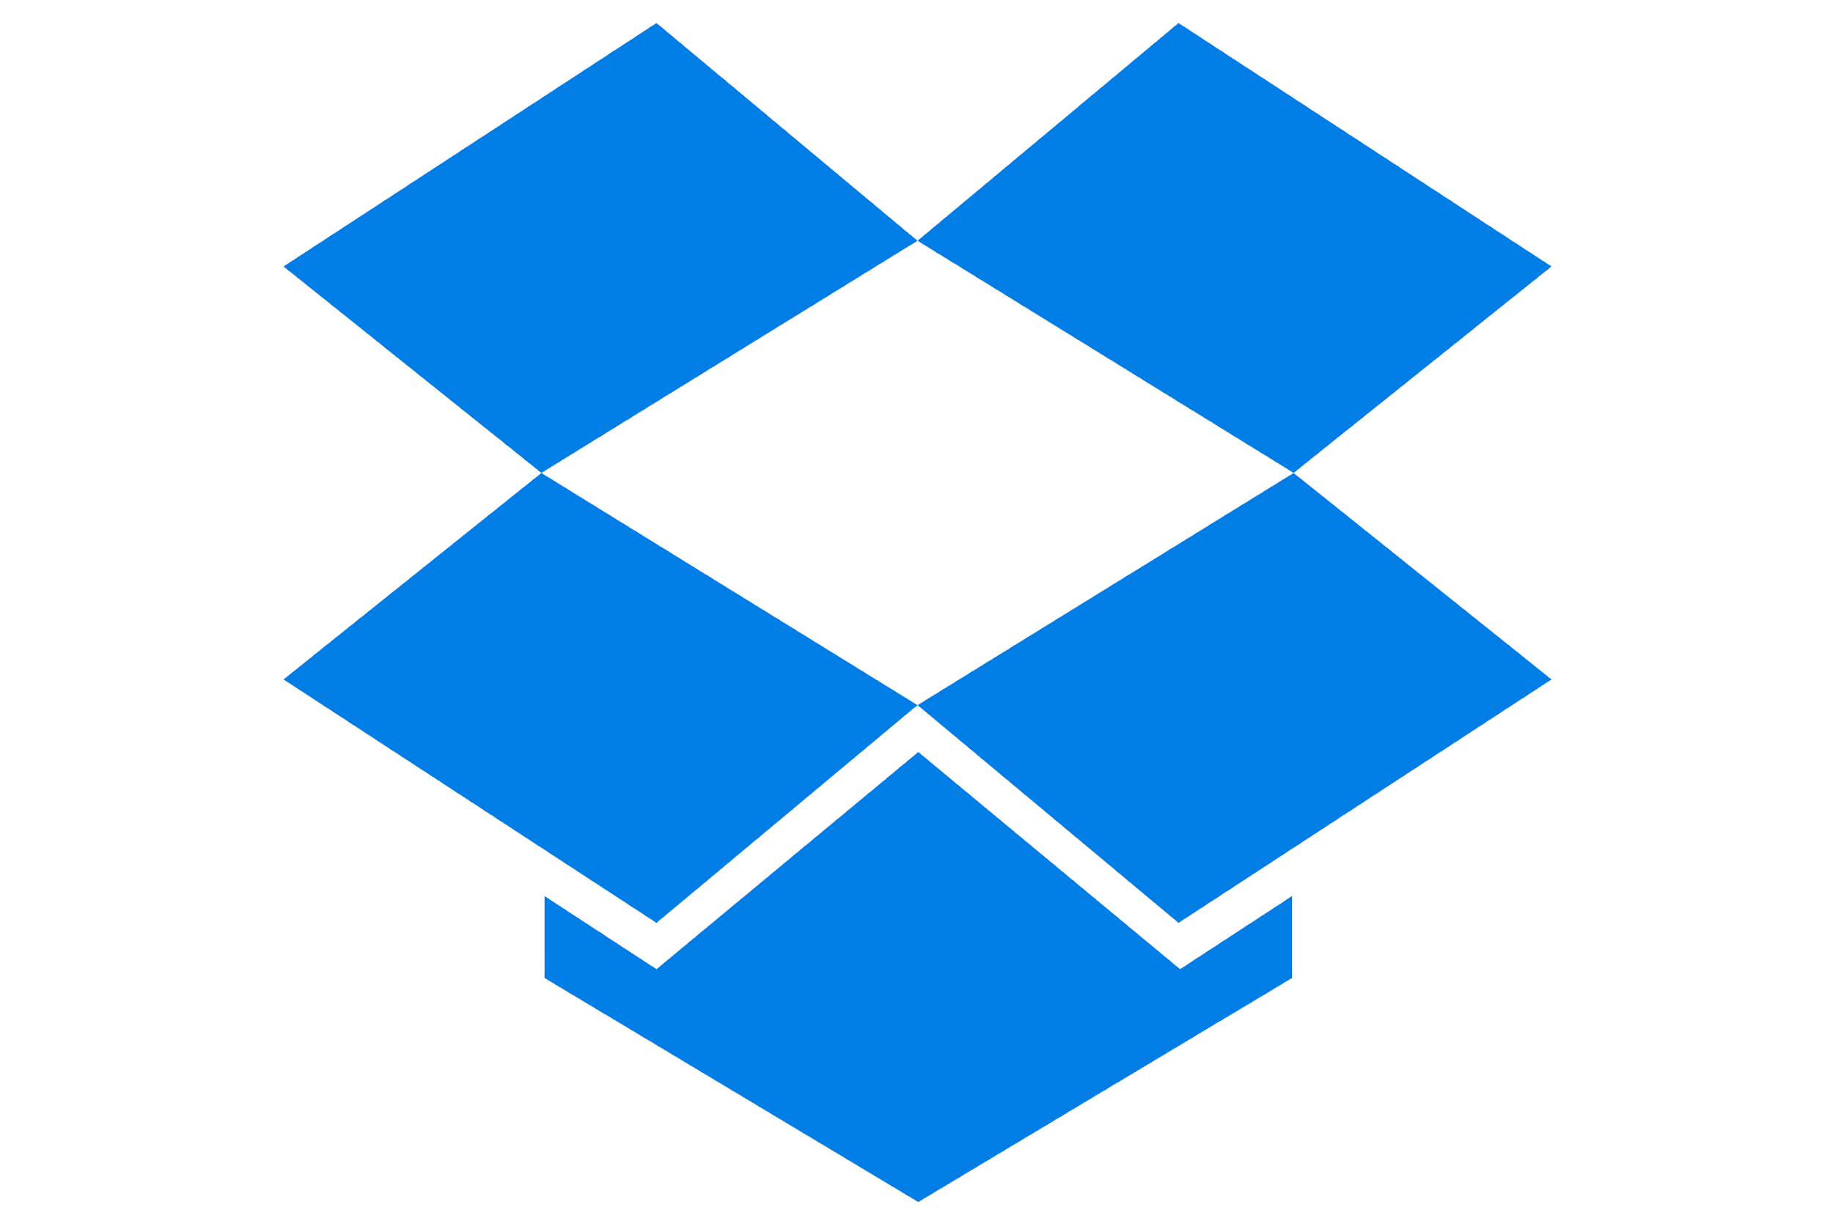
Background & Goals
EZ-Drive is a web application geared towards backing up user files using multiple cloud service APIs.
Google Drive OneDrive Dropbox
Notes:
EZ-Drive is a full stack web application geared towards backing up user files to three of the most popular cloud services: Google Drive, OneDrive, and Dropbox.
This is achieved through utilizing the API libraries for each of these services.

Slide 3
Background & Goals
We hope to achieve the following by the end of this project:
Provide an easy solution for backing up user files
Combine multiple APIs into one web application
Create well designed, aesthetically pleasing interfaces
Notes:
With this project, we hoped to achieve the following points:
One, provide and easy solution for backing up user files
Two, combine multiple APIs into one web application
And three, create well designed and aesthetically pleasing interfaces

Slide 4
Intellectual Merits
The Cloud Service APIs
Google Drive, OneDrive, Dropbox
The services allow us to connect user accounts to our application through the use of OAuth 2.0.
Google Drive API: Introduction to Google Drive API bookmark_border
OneDrive API: Get started using OneDrive API - OneDrive dev center
Dropbox API: Getting Started - Developers
OAuth 2.0 Authorization
This industry standard protocol allows our application to gain access to user resources from their cloud service provider
Learn more about OAuth 2.0
Dropzone.js
Dropzone is an open- source library that provides drag’n’drop file uploads with image previews
Notes:
There are several major intellectual merits we were able to achieve through the creation of this project.
The first is utilizing the cloud service APIs. These API libraries allowed us to authenticate and connect to our user accounts. By doing so, we can seamlessly upload our user files.
The authentication for our users was achieved through the power of OAuth 2.0 Authorization, which is an industry standard protocol for gaining access to user resources from another application.
Within our application, users can interact with a drag and drop file box for easy attachment of the files they want to upload. This is done by utilizing the open source javascript library, Dropzone.

Slide 5
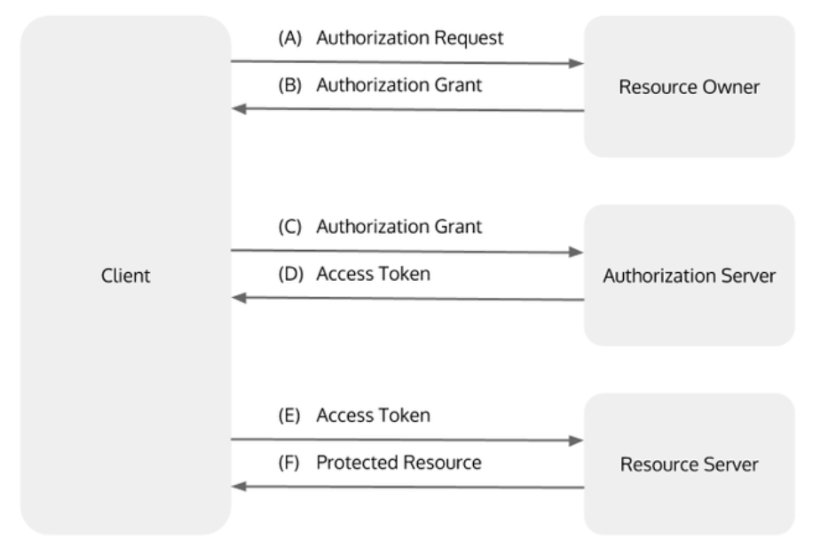
Intellectual Merits
OAuth 2.0 Authorization flowchart:
Notes:
Here is a more in depth look at how the OAuth 2.0 authorization process takes place. As you can see, there are four main components:
The client, which is our application
The resource owner, which is anyone using our application
The authorization server, which is the server used by one our the cloud services for authenticating user credentials
And the resource server, which is were the users resources are held, such as Google Drive itself

Slide 6
Broader Impacts
Our application provides ease of use to the user allowing them to backup their important files seamlessly between the three most prominent Cloud Services.
This not only saves the user time, but also provides peace of mind knowing that their files have been backed up through multiple sources.
Notes:
The broader impacts our application provides are easy of use for the user by allowing them to backup their important files seamlessly between multiple cloud services. This not only saves them time, but provides peace of mind knowing that their files are secured through multiple sources.

Slide 7
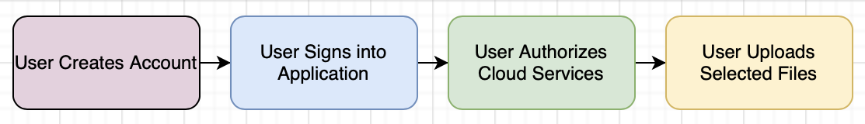
Design Specifications
System Overview:
EZ-Drive is built upon a user-based login system. When accessing our application, users will be prompted to log in or create an account. Once a user is signed in, they can begin connecting their cloud service accounts.
Here is a basic design diagram:
Notes:
EZ-Drive is build upon a user-based login system. This system extends functionality for the rest of our application including authorizing cloud services and uploading user files.
Here is a basic design diagram showing the flow of our application. Lets go more in depth for each section.

Slide 8
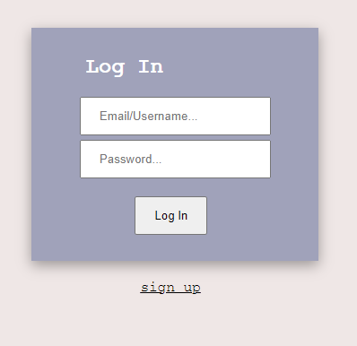
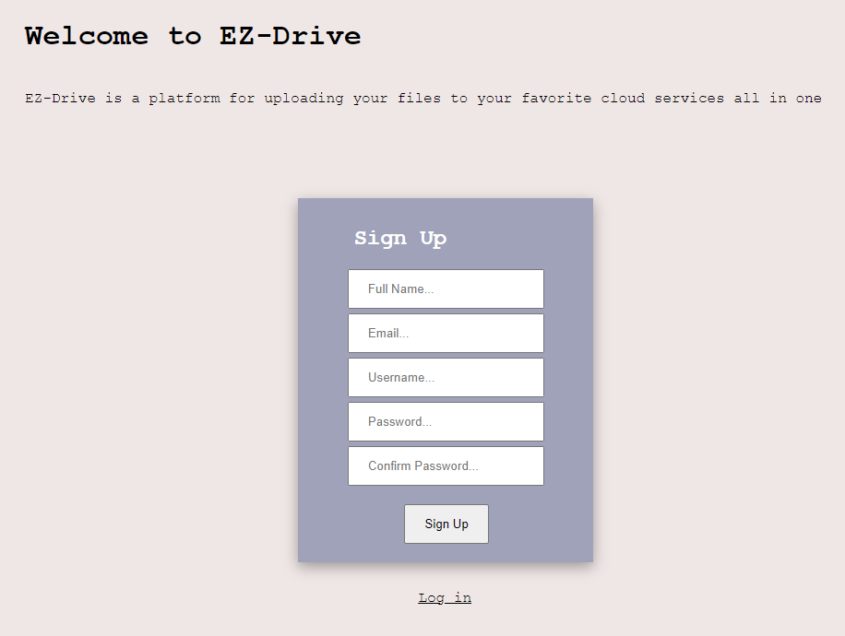
Design Specifications
System Overview:
First, a user will either log in to an existing account or sign up for a new one.
Notes:
Here is a look at the login in and signup screens. When a user first access our application they will be prompted to login, but can sign up for an account if needed.

Slide 9
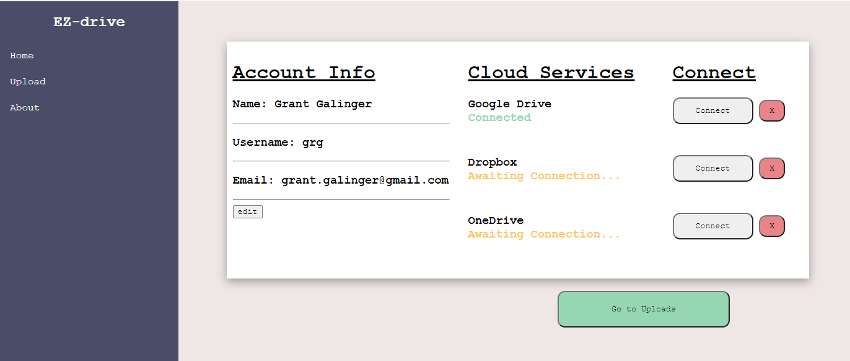
Design Specifications
System Overview:
At the Home screen, users are presented with an overview of their account status and can then connect their Cloud Service accounts.
Notes:
Here is a look at the Home screen of our application. As you can see, there are three main sections:
Account Info, which displays the users basic account information
Cloud Services, which displays the connection status of each cloud service
and Connect, which has a connect and disconnect button for each cloud service
Once logged in, users can begin connected the cloud services they want to use. It is not required for users to upload their files to all three available services, so choosing just one or two works fine. The connection process can begin by clicking one of the “connect” buttons.

Slide 10
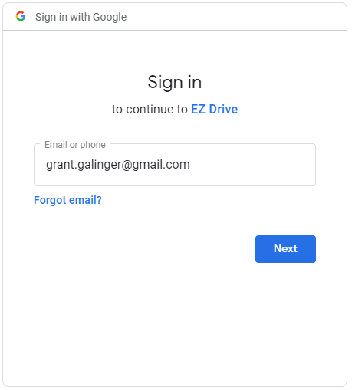
Design Specifications
System Overview:
The account authorization takes place through OAuth 2.0. When a user connects a cloud service account, they are prompted with a login screen for that particular cloud service. A successful login grants our application access to their cloud service account.
Google Drive
Notes:
This is where the OAuth 2.0 authorization process starts. Once a users clicks “connect” they are prompted with a login screen for the cloud service they are trying to access. A successful login from the user will grant our application access to the resources in their cloud service account and redirect the user back to EZ-Drive.
This is an example of the screen presented to as user when connecting to a Google Drive account.

Slide 11
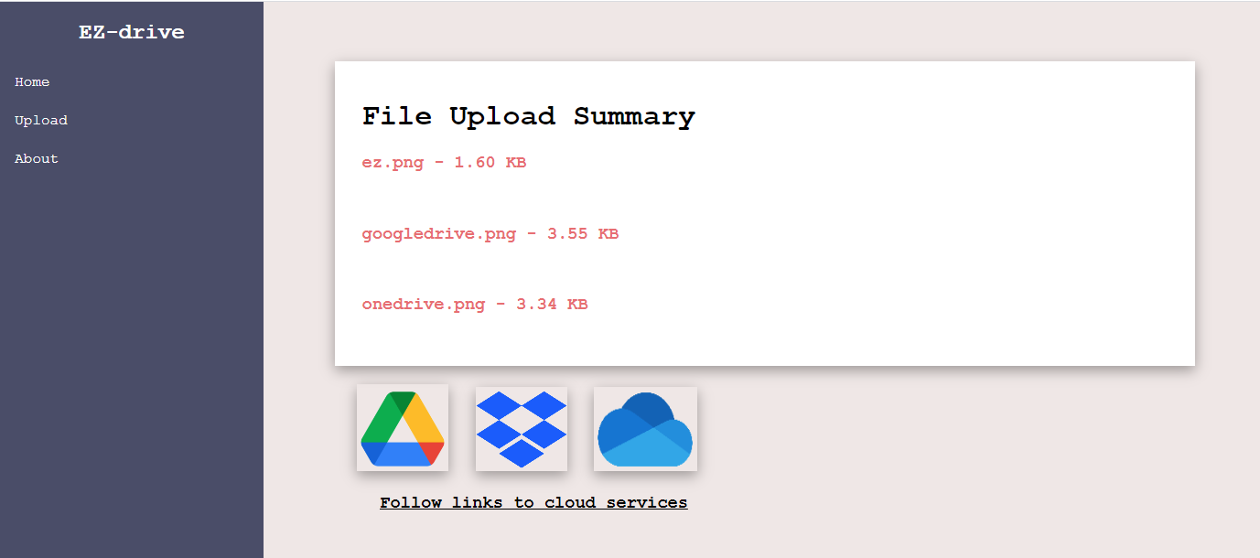
Design Specifications
System Overview:
Once the users desired cloud service accounts have been authorized and connected, they can proceed to the Uploads page. Here, they can either select or drag’n’drop their files to be uploaded.
Notes:
Once the upload process is complete, users are presented with a Results page. This page shows a list of the uploaded files and their sizes, as well as links to each of the cloud services.
This wraps up the system overview for our application.

Slide 12
Design Specifications
System Overview:
After files have been successfully uploaded, a Results page will be displayed showing a list of the files, as well as links to each of the Cloud Services.
Notes:
Once the upload process is complete, users are presented with the Results page, which shows a list of the uploaded files and their sizes, as well as links to each of the cloud services.
This wraps up the system overview for our application.

Slide 13



Technologies
EZ-Drive is built primarily on PHP and JavaScript technologies. Our application is powered through a PHP database known as phpMyAdmin, and the design is created through HTML and CSS.
The Cloud Service APIs are implemented through a technology called Composer. This allows our project to import pre-existing libraries built for utilizing these APIs.
Notes:
EZ-Drive uses a handful of technologies to get its job done. PHP and JavaScript are the main drivers. phpMyAdmin powers the database solution and HTML and CSS are behind the design. Composer allows us to implement the cloud service APIs using some pre-existing libraries.

Slide 14
Technologies
PHP is a server-side scripting language that is used to develop static/dynamic websites or web applications.
Our application uses PHP for:
Cloud Service API integration
Creating and displaying user account information
Creating user Sessions
Uploading user files (in combination with Dropzone.js)
Transferring data to and from our database
Notes:
As mentioned earlier, PHP is one of the main drivers behind EZ-Drive. It powers all of the server-side operations of the application. Some examples include integrating with cloud service APIs, creating user accounts and sessions, uploading files in conjunction with Dropzone.js, and all database operations.

Slide 15


Technologies
Our application is powered through the PHP database known as phpMyAdmin. Here, all of our user data is stored, as well as the authorization data for each of the Cloud Services our users are connected to.
MySQL is used to interact with that data stored in our database.
PHP Documentation: Welcome to phpMyAdmin's documentation! — phpMyAdmin 5.2.0-dev documentation
Notes:
Our database solution for EZ-Drive is phpMyAdmin. phpMyAdmin is a PHP solution that allows us to use MySQL in a web application. The database handles user information including accounts and all necessary authorization data for connecting with cloud services. A documentation link is provided for those who would like to learn more about phpMyAdmin.

Slide 16
Technologies
Composer is a tool for dependency management in PHP. It allows you to declare the libraries your project depends on and it will manage (install/update) them for you.
These are the libraries our application uses:
Google Drive - google/apiclient
OneDrive - krizalys/onedrive-php-sdk
Dropbox - kunalvarma05/dropbox-php-sdk
Notes:
In order to make EZ-Drive work, some pre-existing libraries were used to connect our application to Google, Dropbox, and OneDrive through APIs. Composer is a very useful dependency management tool that will install and update dependencies as needed. Links are provided for all of the libraries we used.

Slide 17


Technologies
Our application is designed through HTML and CSS. We decided to go with a sleek and minimalistic approach to our design. We feel that this adds to the overall clean and simple aesthetic we are trying to achieve.
Follow the link here to view a gallery of photos so far of our application: EZ-Drive Image Portfolio
Notes:
As a web application, the design for EZ-Drive was done using HTML and CSS. As an overall design philosophy, we decided the design should be sleek and minimal to complement the ‘easy-to-use’ approach we have aimed for for this project. A gallery of photos is available to view at the link provided.

Slide 18
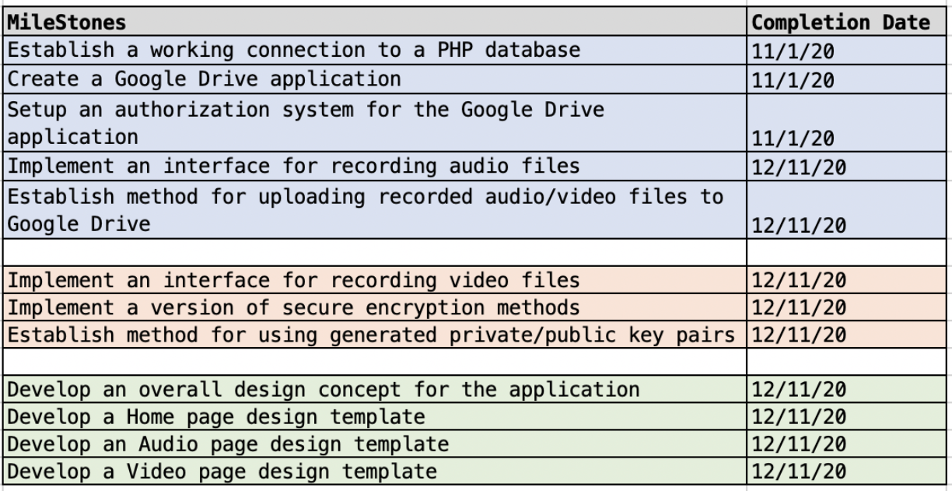
Milestones
Here is a list of our original milestones for this project. Our vision for this application has changed slightly overtime, so some of the milestones will be altered in the future.

Slide 19
Results
So far, we have achieved several major milestones progressing our project forward:
User based login system and account creation (Jan 10th)
Connecting/utilizing phpMyAdmin database (Jan 10th)
Google Drive API implementation (Jan 25th)
Dropzone.js file uploading system (Jan 31st)
Dropbox API implementation (Feb 10th)
Created and designed most of the pages and interfaces (Feb 18th)

Slide 20
Challenges
There have been several challenges in getting the application to its current state.
Configuring and setting up each of the Cloud Service APIs was challenging at times and certainly a learning experience.
Each of them have similarities in how they function, so once we got the first one working, which was Google Drive, the next two were not as time-consuming.
Another challenge we are currently facing is getting Composer to work properly with all three of our required libraries.
Initially, when building the foundation for one of the Cloud Service APIs, we do so in a separate project to minimize potential errors. Then, once we get it to work, we migrate our testing into our main project.
When updating our Composer install in our main project, we are sometimes getting errors. This is something we are currently debugging.
One challenge we will soon face is migrating our application to a hosted url.
This will be one of the last major hurdles for our project so that it can be viewed and accessed by the public.

